Slide 1
Instructions for the teachers
Dear colleagues,
This is a very easy paragraph. Students will be able to memorize it easier than any other ever I hope. Before starting presentation you may see the content and read the notes below the pages in normal mood. It is all the better to present the content.
Thanking you
Md. Hasan Hafizur Rahman
Notes:
Please see the instructions here before going to present the content in the class.

Slide 2
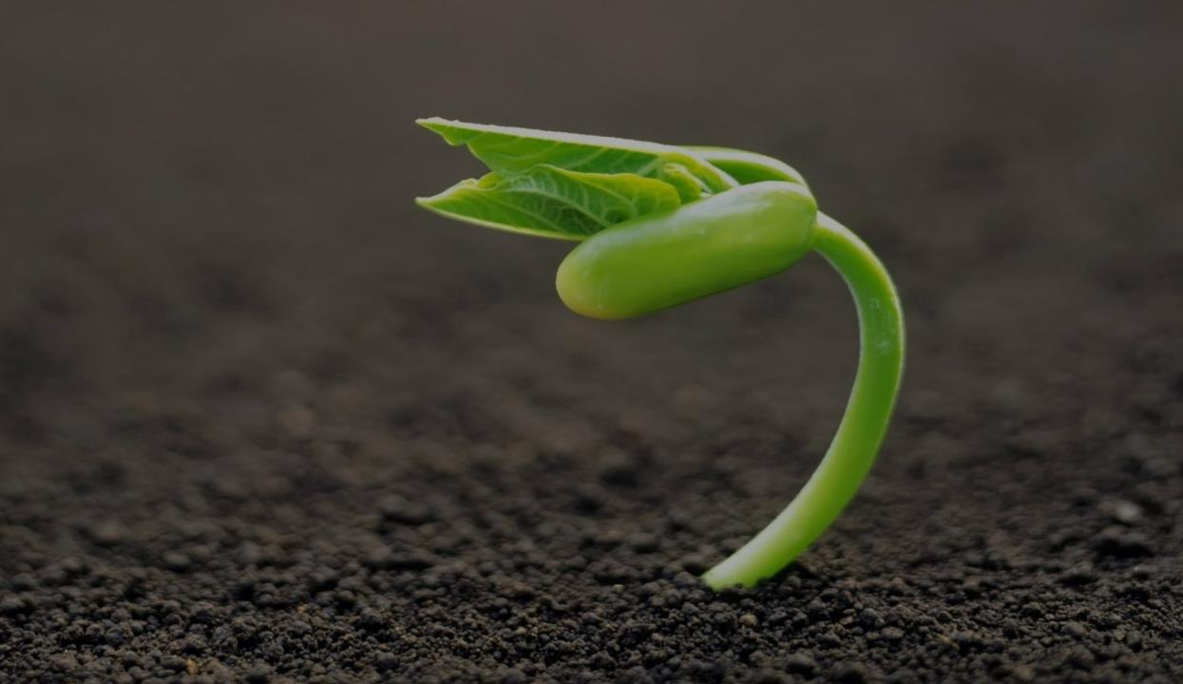
Welcome to my class
dear students.
Notes:
Welcome slide.

Slide 3
Md. Hasan Hafizur Rahman
Lecturer (English)
Cambrian School & College,
Dhaka .
Class IX-X
Subject : English 1st paper
Introduction
Notes:
Introduction of the teacher & the class.

Slide 4
Let us watch and sing together.

Slide 5
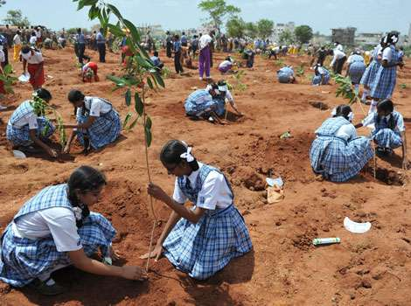
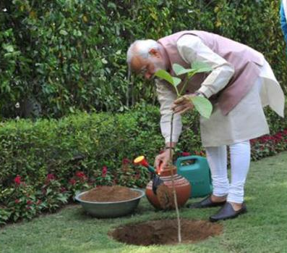
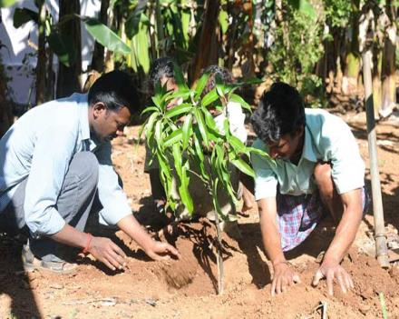
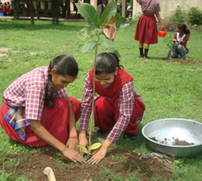
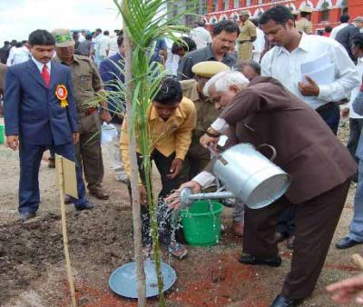
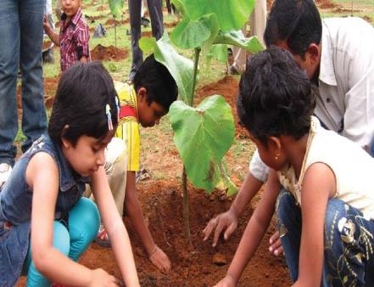
What are they doing in the pictures?
They are planting trees.
Notes:
Suspension to take out the lesson name from the students.

Slide 6
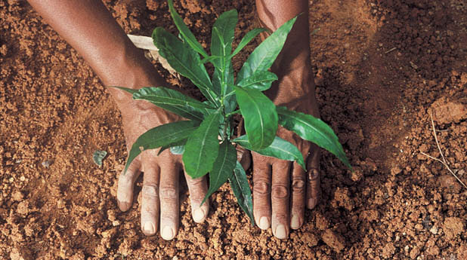
Our today’s lesson is-
Tree Plantation
(Paragraph)
Notes:
Lesson declaration.

Slide 7
Learning outcomes
After studied this lesson, students will be able to—
tell what tree plantation is
describe the importance of tree plantation
tell about the effect of deforestation
write a paragraph
Notes:
Speaking, listening & writing skills will be focused in this lesson.

Slide 8
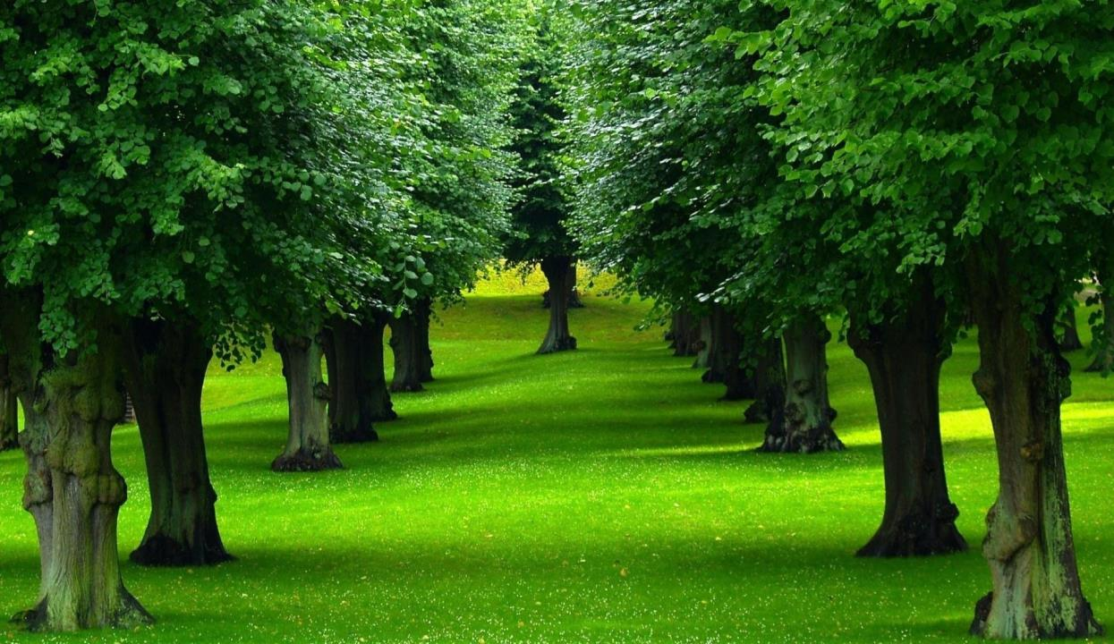
Trees are the most important element
of nature and environment.
Notes:
Introduction of the topic.

Slide 9
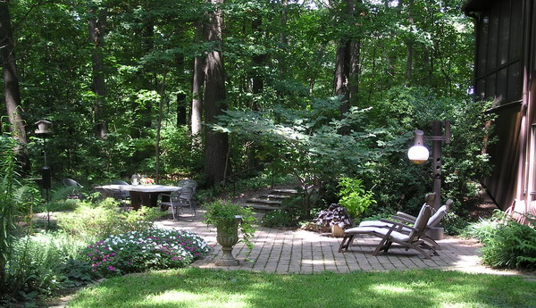
We cannot think a healthy environment without tree.
Notes:
Introduction of the topic.

Slide 10
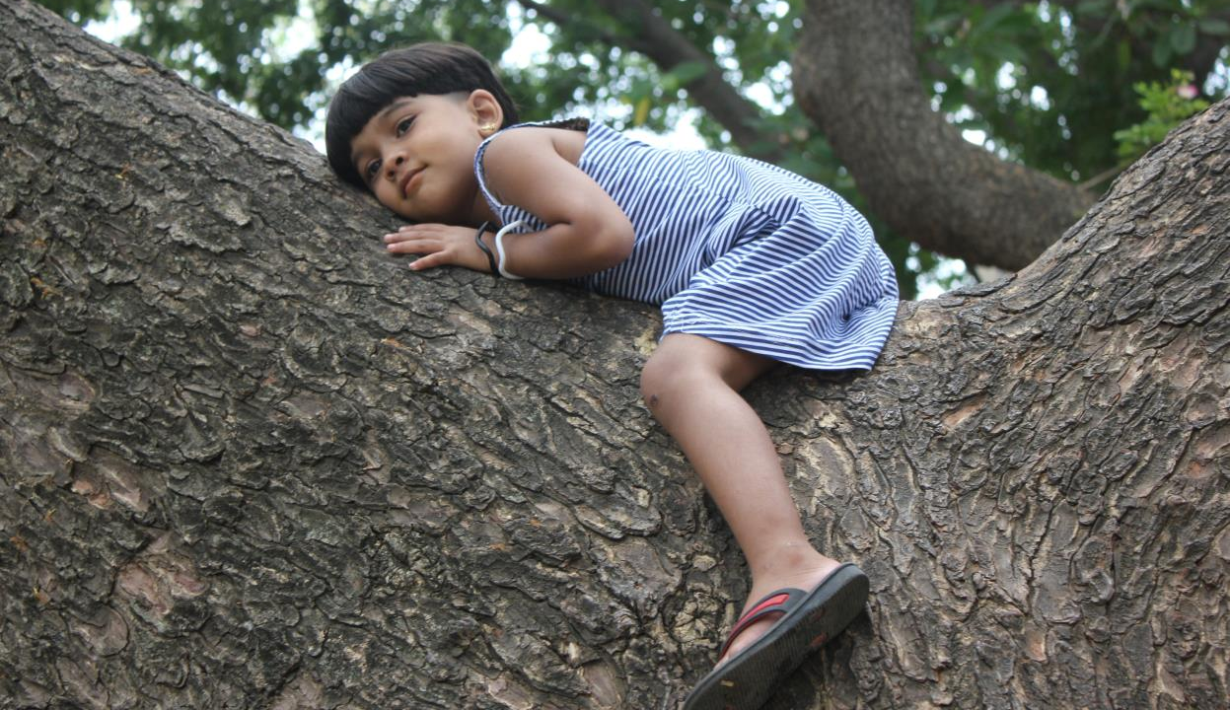
Tree is our most intimate friend.
Notes:
Tree is a friend in deed.

Slide 11
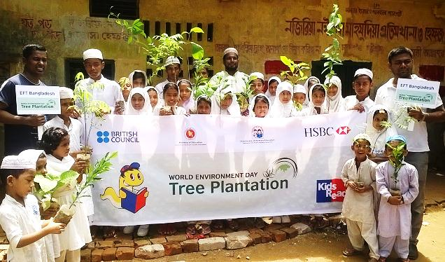
So what is most essential/ important for us?
So tree plantation is most essential and important for us.
Notes:
Importance of tree plantation.

Slide 12
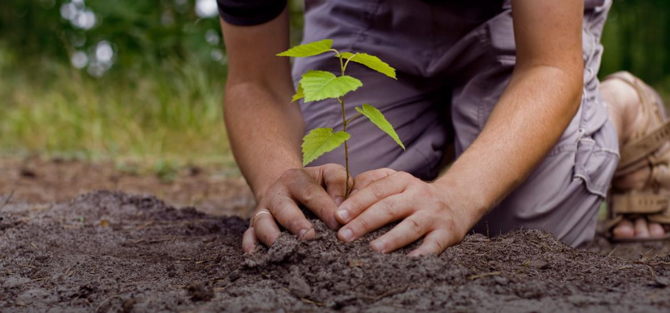
What is tree plantation?
Tree plantation means planting/growing trees.
Notes:
Definition of tree plantation.

Slide 13
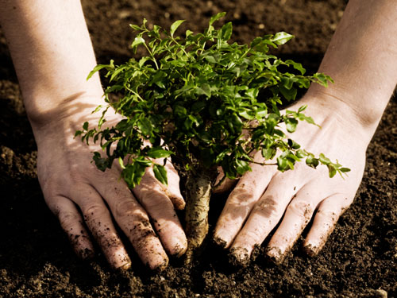
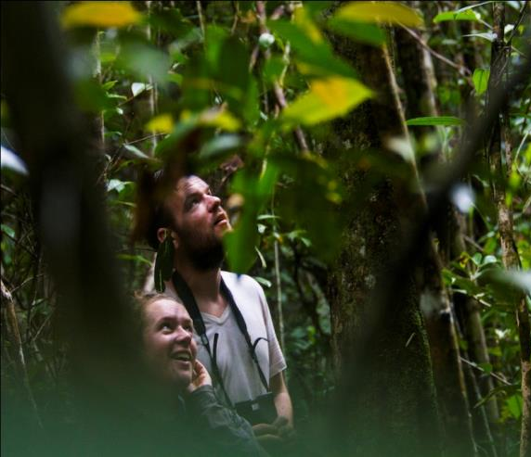
Why should we plant trees?
We should plant tree for our existence as we cannot live without oxygen.
Notes:
Our duty.

Slide 14
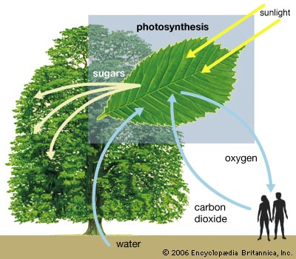
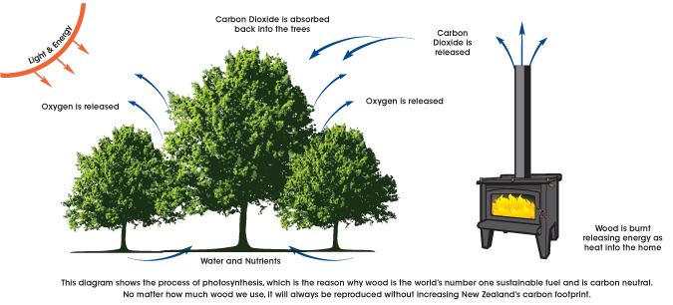
Trees are the factory of receiving carbon dioxide and releasing oxygen. We live by receiving oxygen from the tree.
Notes:
Necessity of oxygen that we find from trees.

Slide 15
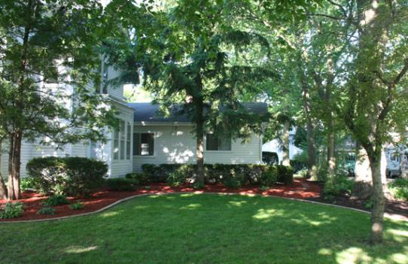
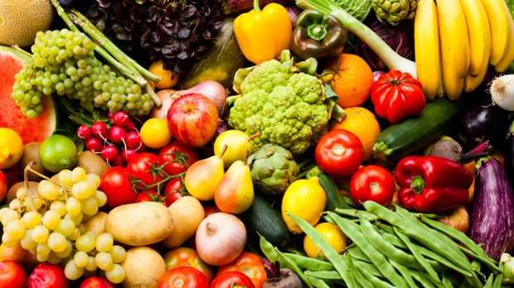
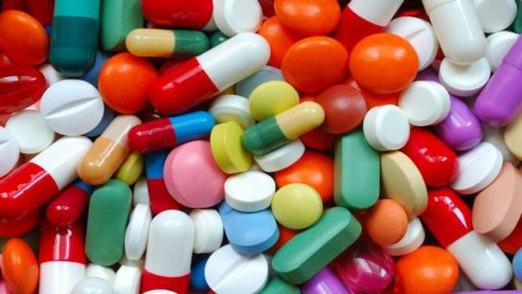
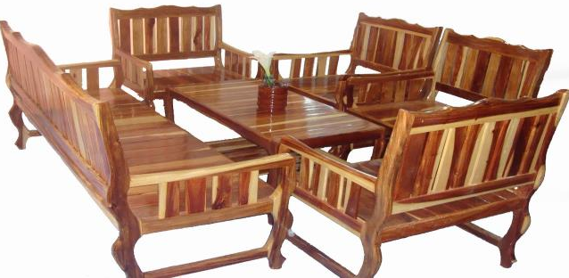
It provides us with shed, food, medicine and furniture.
Notes:
Necessity of tree.

Slide 16
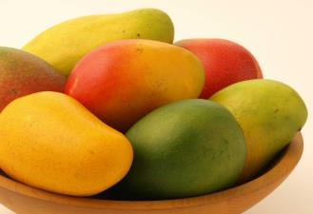
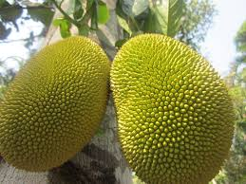
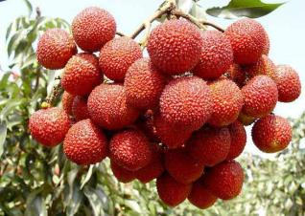
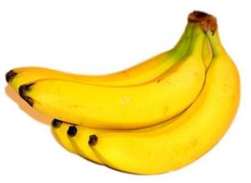
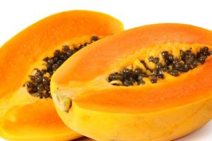
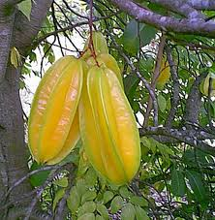
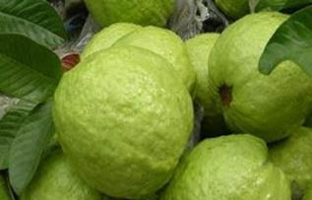
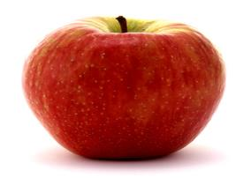
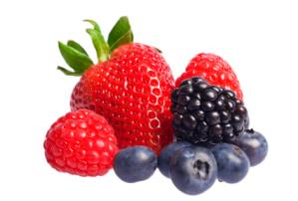
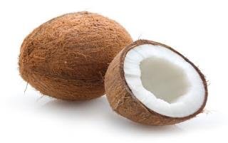
We fill our thirst of taste with interesting fruits all the year round.
Notes:
Tree meets out fruits thirst.

Slide 17
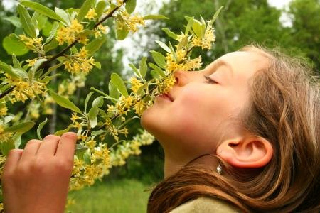
We feel delight with the beauty of flowers and sweet smell.
Notes:
We are fond of trees.

Slide 18
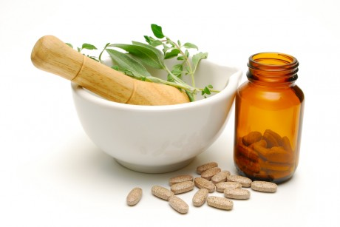
It keeps us physically fit providing medicine and herbs.
Notes:
Medicine is made from trees.

Slide 19
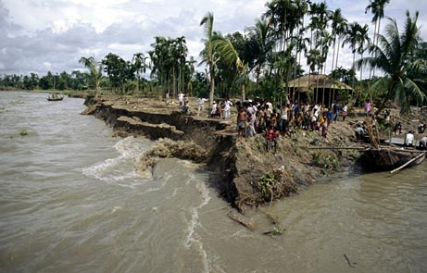
Moreover, it protects river erosions.
Notes:
Necessity of tree is shown here.

Slide 20
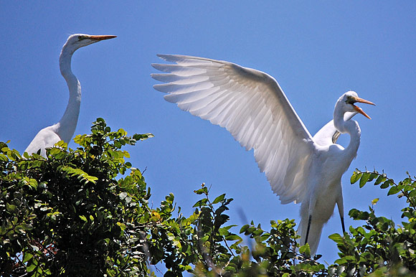
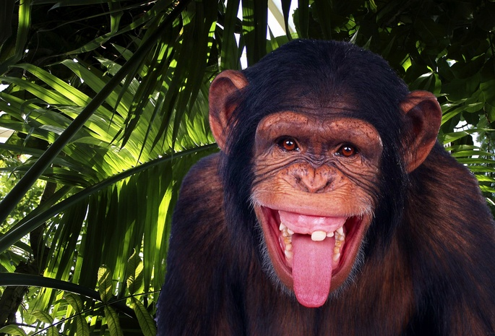
It gives shelter to the birds and beasts.
Notes:
Habitation of birds and beasts.

Slide 21
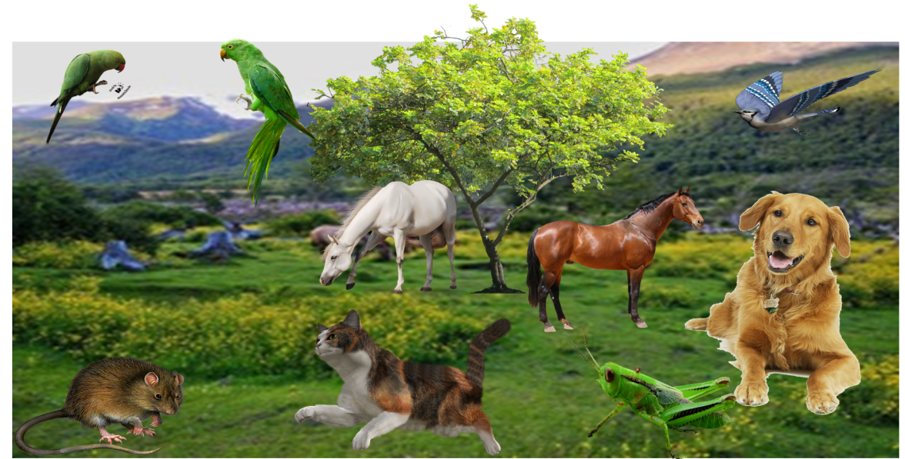
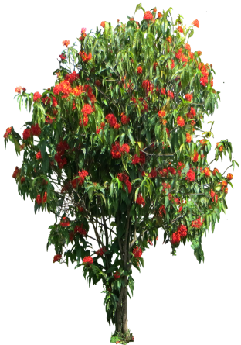
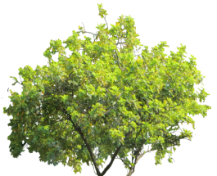
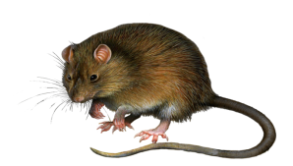
It ensures the ecological balance of our environment.
Notes:
An ecological balanced environment (প্রাকৃতিক ভারসাম্যপূর্ণ পরিবেশ) includes birds, animals, little creatures, trees and all kinds of living beings.

Slide 22
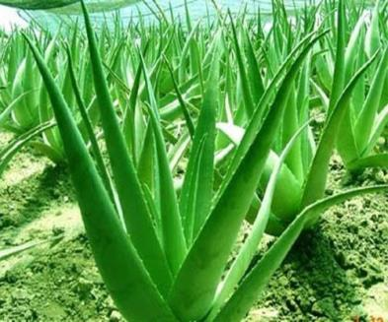
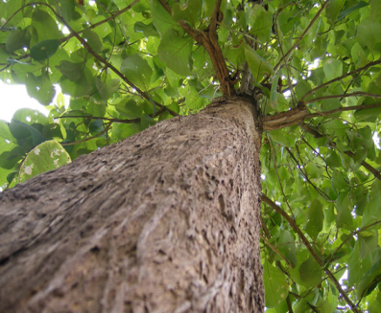
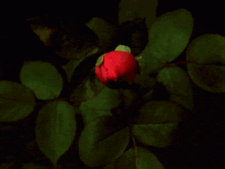
What kinds of tree should we plant?
We should plant all kinds of tree like medicinal tree, flower tree, tree of furniture and shelter.
Notes:
There are so many medicinal plants like (তুলসী পাতা গাছ, নিসিন্দা গাছ, নিম গাছ) etc. Only three shown here.

Slide 23
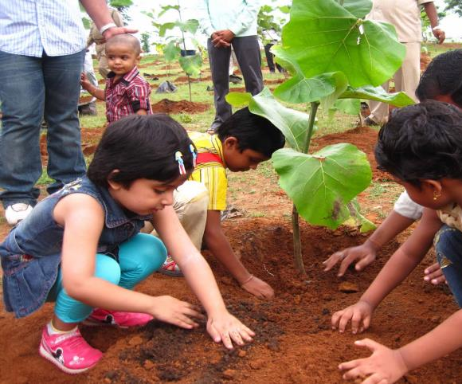
What is the best time to plant tree?
01-07
The first week of July is the best time of planting tree because it is the tree planation week.
Notes:
Tree plantation week is highlighted here.

Slide 24
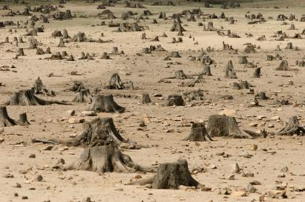
What happens if we do not plant tree?
If we do not plant tree, the country will be turned into desert for deforestation and all living beings will loss their existence.
Notes:
Cutting trees at random turns a country into desert and existence of life is destroyed shown here.

Slide 25
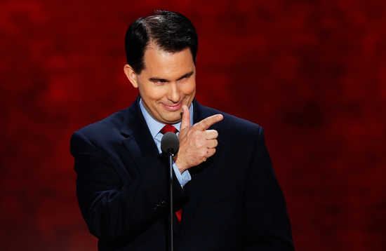
So the importance of tree plantation is easily realized.
Notes:
Importance of tree plantation is acknowledged here.

Slide 26
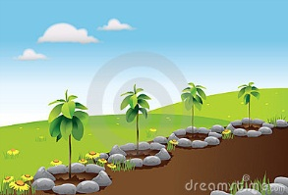
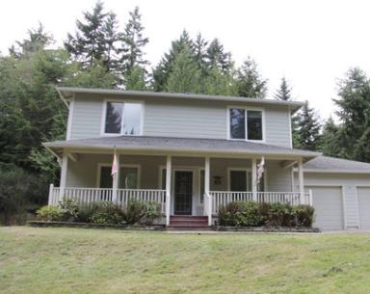
What should be our duty now?
That’s why we should plant trees more and more in any blank space like open and unused place, by the side of the house, roads, high ways, by the side of schools, colleges and offices to ensure a happy ,healthy and fresh environment.
Notes:
Our duty is recommended here.

Slide 27
Suppose, you and some of your friends live in a residential area near a river. There is not enough tree in that locality and for that the area is in the victim of river erosion. The heat of the sun is un bearable. Moreover, you cannot enjoy the natural scenery and chirping of birds. Now write a paragraph in a group how to make your area green and make it a suitable environment.
Group Work
Notes:
Group work.

Slide 28
Home Work
Write a paragraph on
“ The importance of Tree Plantation”
with the information you learnt from your class.
Notes:
Assignment at home.

Slide 29
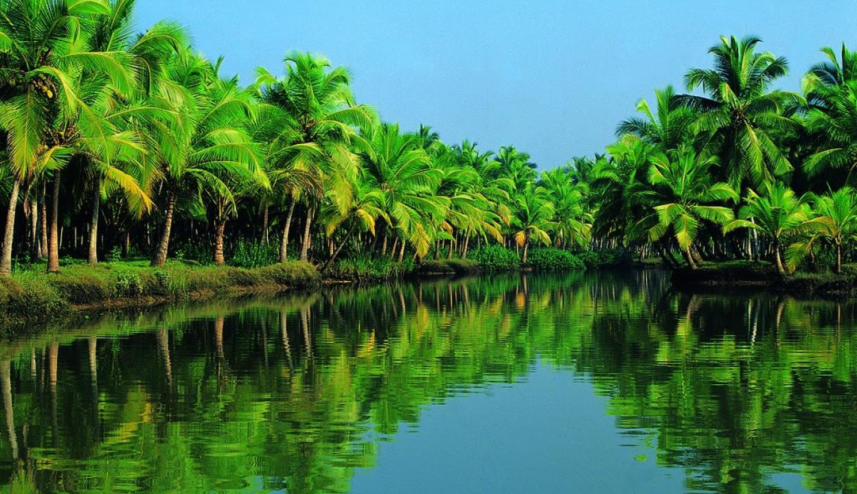
Aallah Hafez
Notes:
Ending slide.

Slide 30
Trees are the most important element of nature and environment. We cannot think a healthy environment without tree. It is our most intimate friend. So tree plantation is most essential for us. Tree plantation means growing trees. We should plant tree for our existence as we cannot live without oxygen. We live by receiving oxygen from the tree and releasing carbon dioxide. Trees are the factory of receiving carbon dioxide and releasing oxygen. It provides us with shed, food, medicine and furniture. We fill our thirst of taste with interesting fruits all the round. We feel delight with the beauty of flowers and sweet smell. It keeps us physically fit providing medicine and herbs. Moreover, it protects river erosions. It gives shelter to the birds and beasts. It ensures the ecological balance of environment. We should plant all kinds of tree like medicinal tree, flower tree, tree of furniture and shelter. The first week of July is the best time of planting tree because it is the tree plantation week. If we do not plant tree, our country will be turned into desert for deforestation and all living beings will loss their existence. So the importance of tree plantation is easily realized. That’s why we should plant trees more and more in any blank space like open and unused place, by the side of the house, roads, high ways, by the side of schools, colleges and offices to ensure a happy ,healthy and fresh environment.

